Slide 1


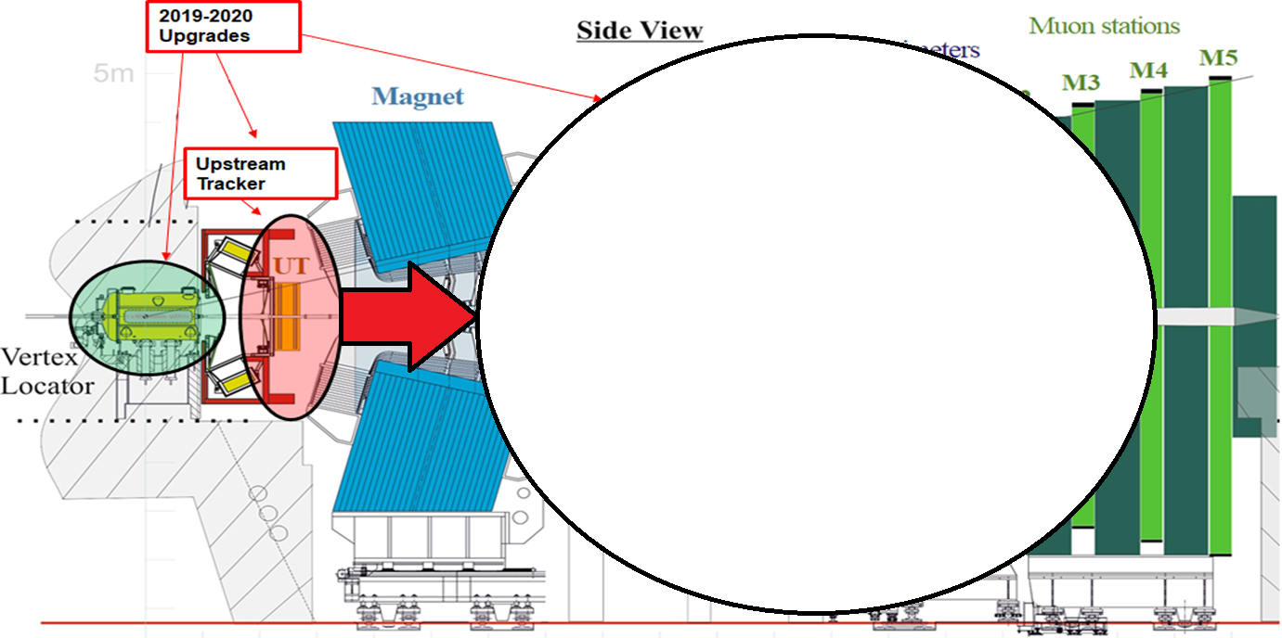
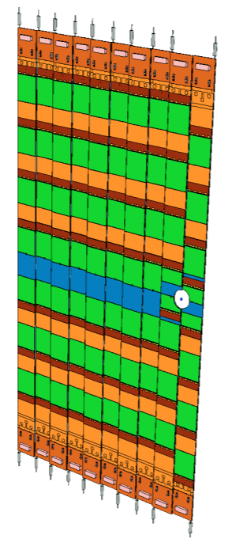
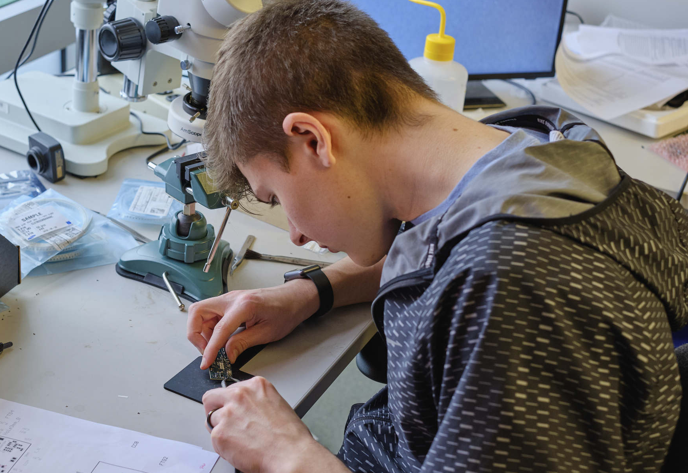
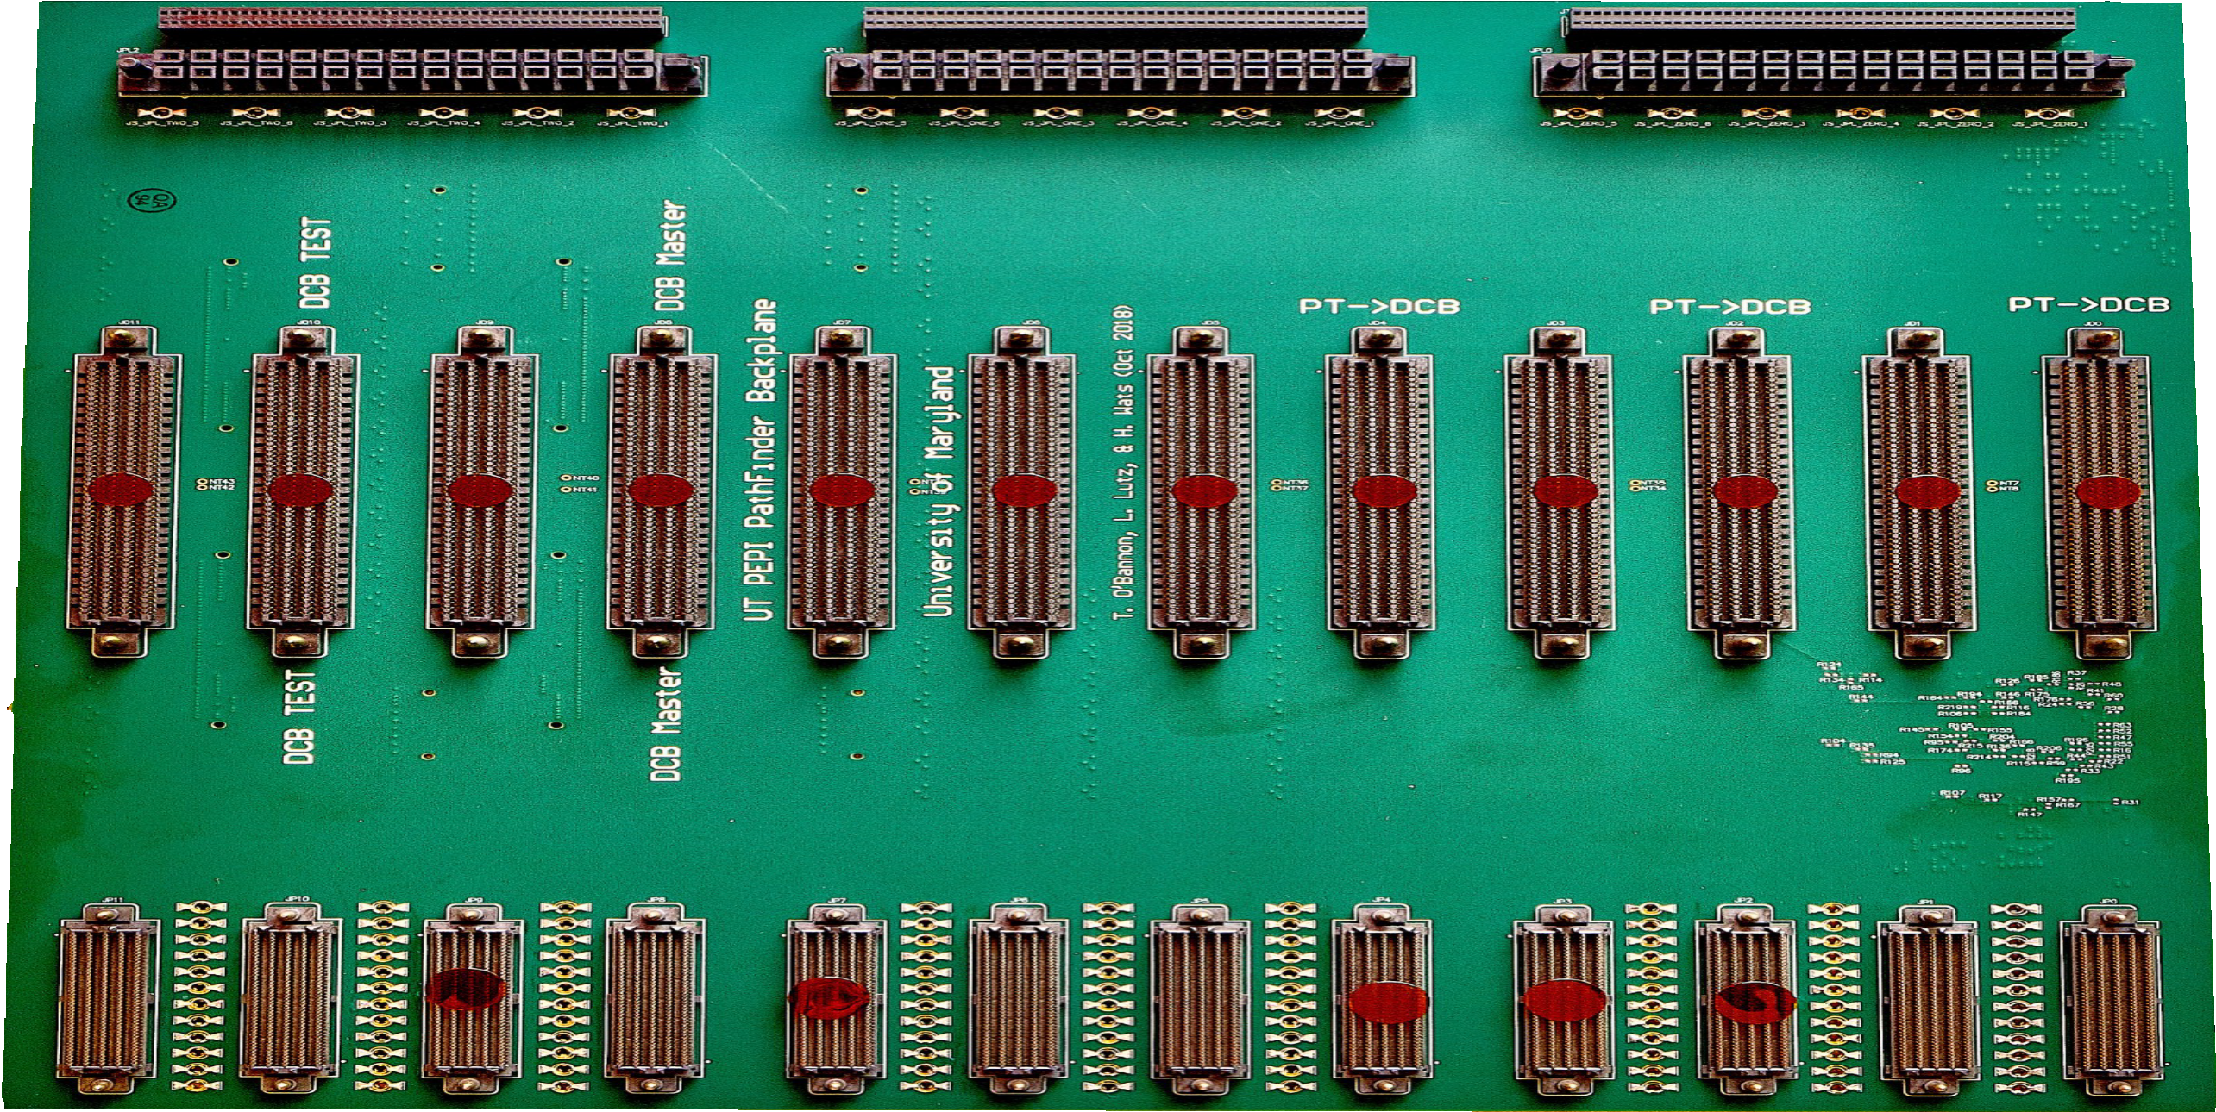
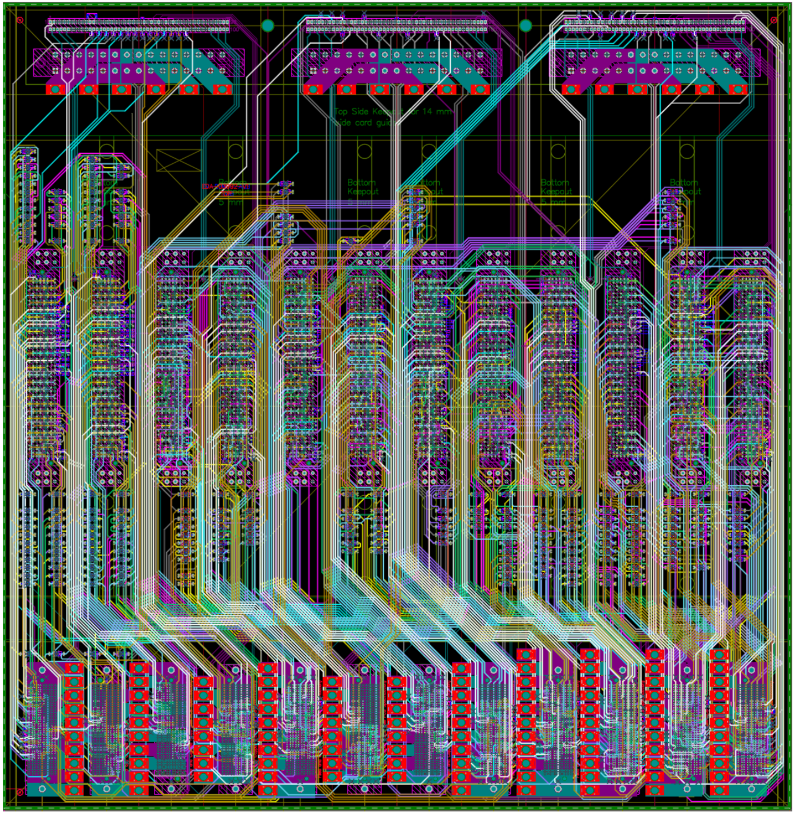
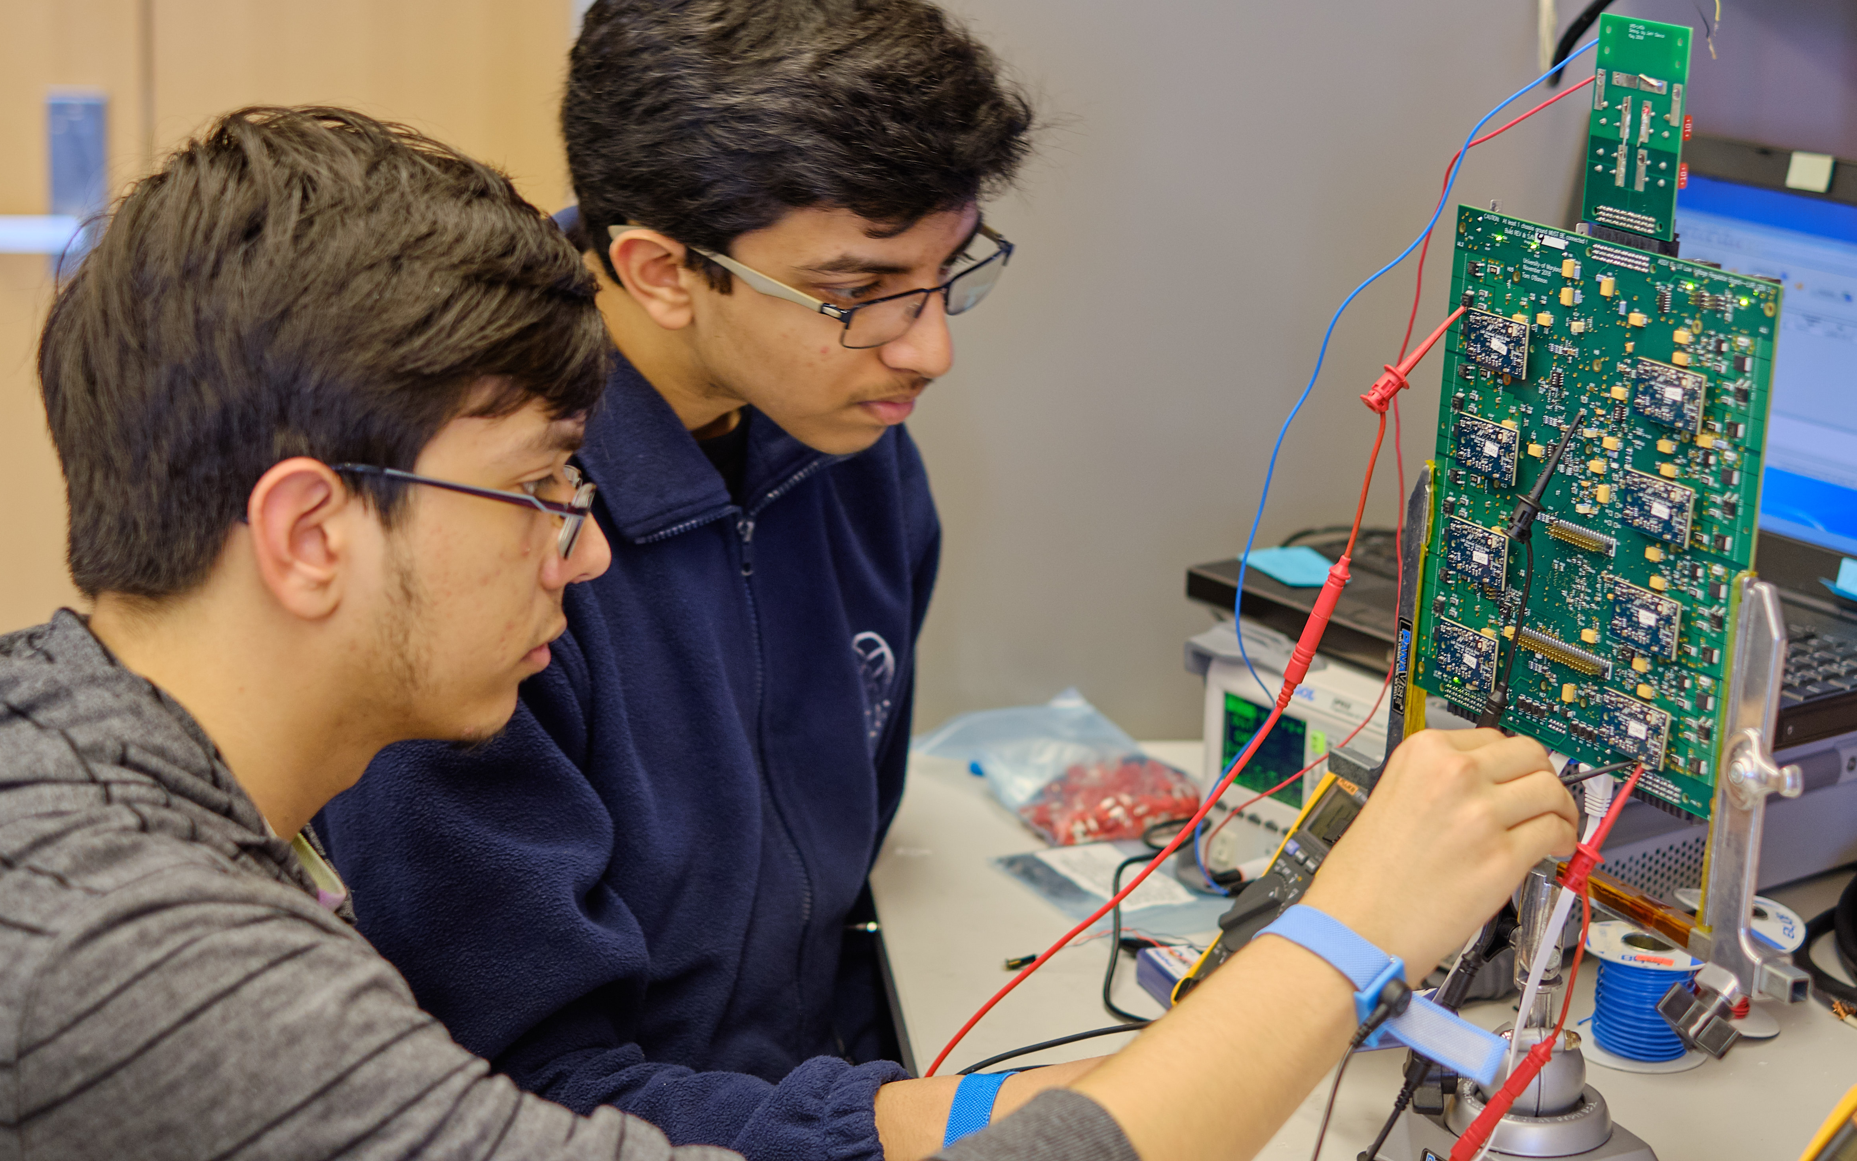
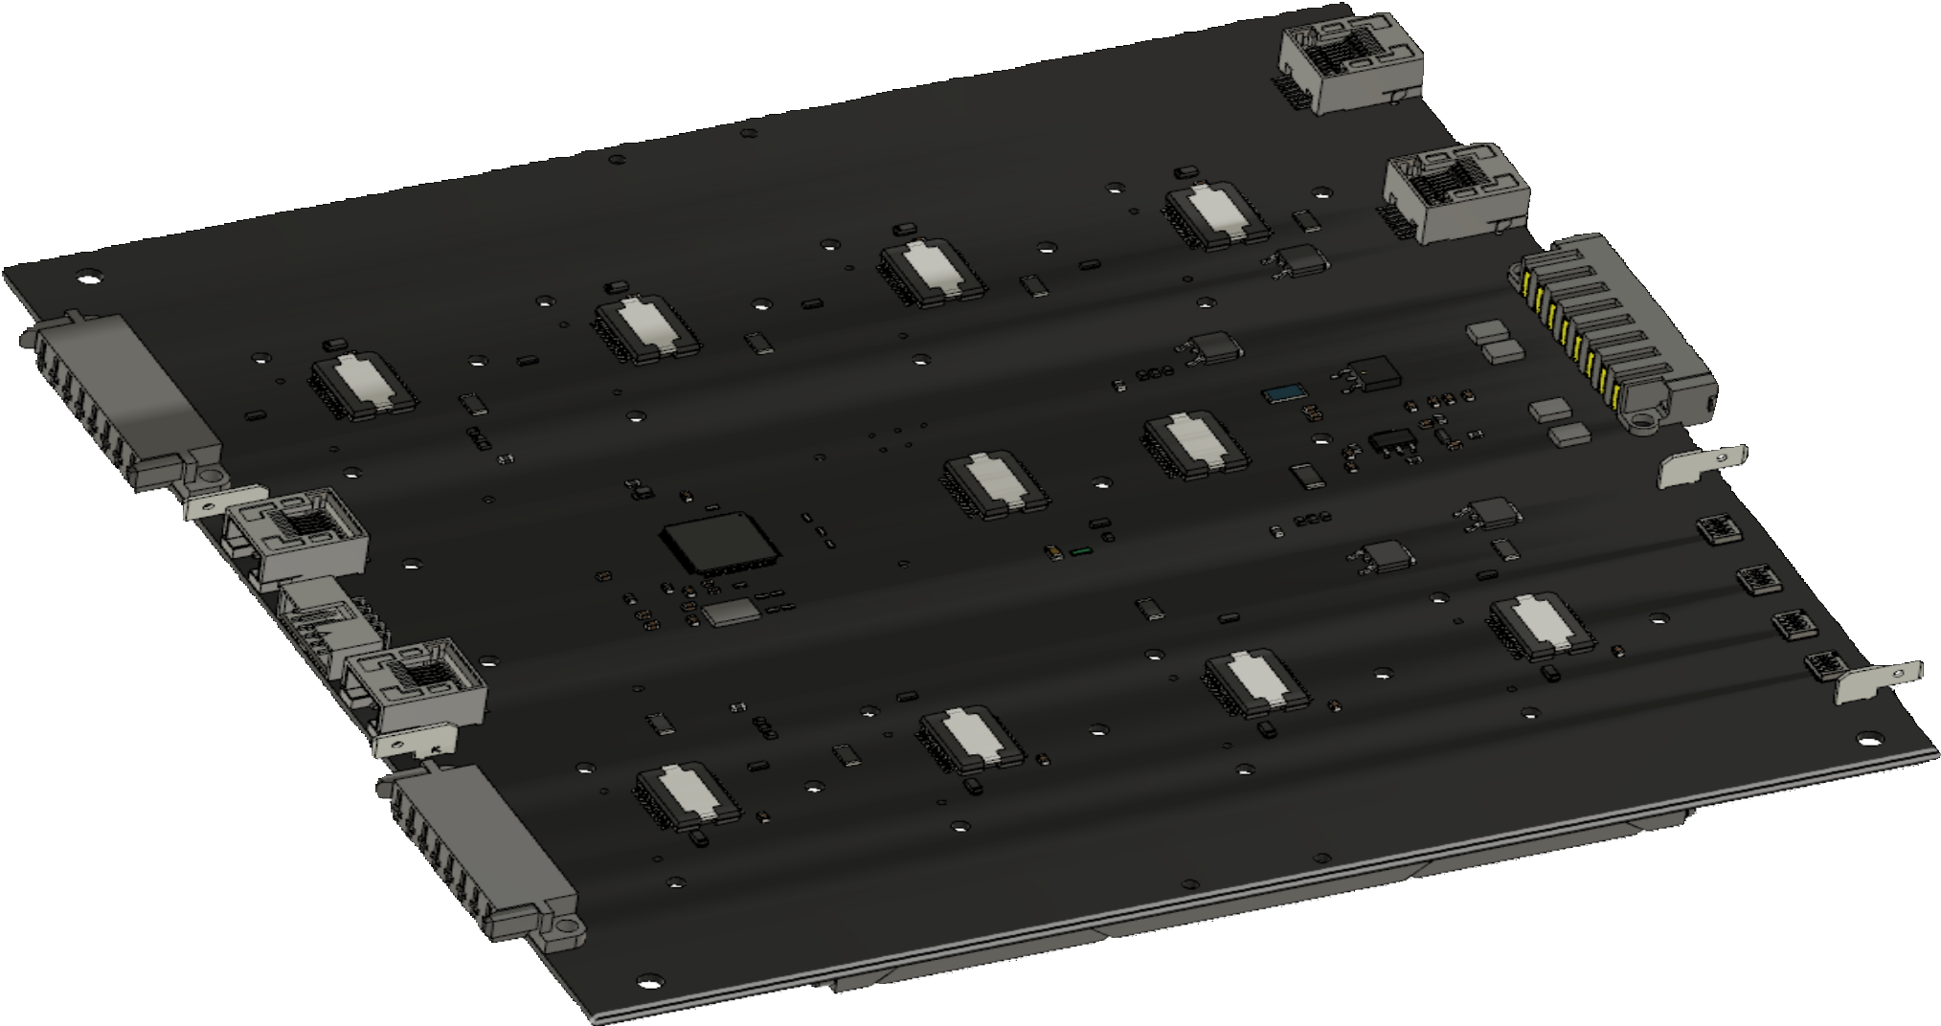
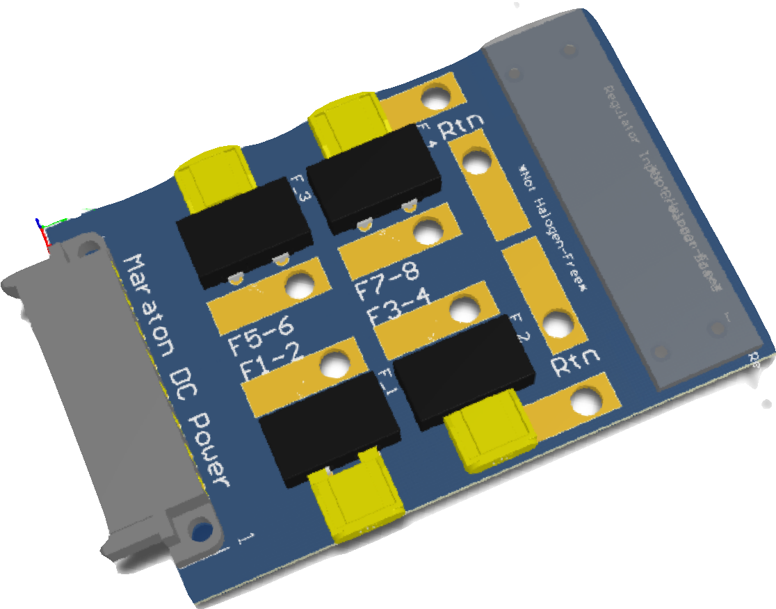
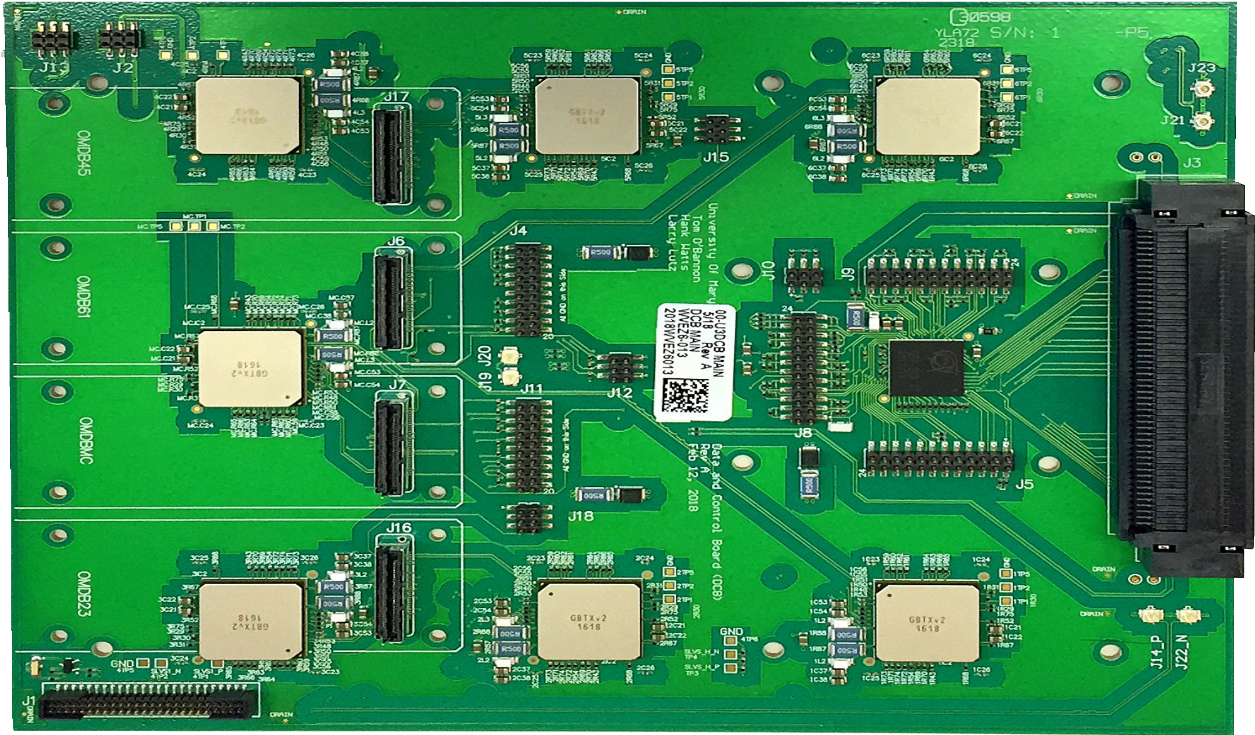
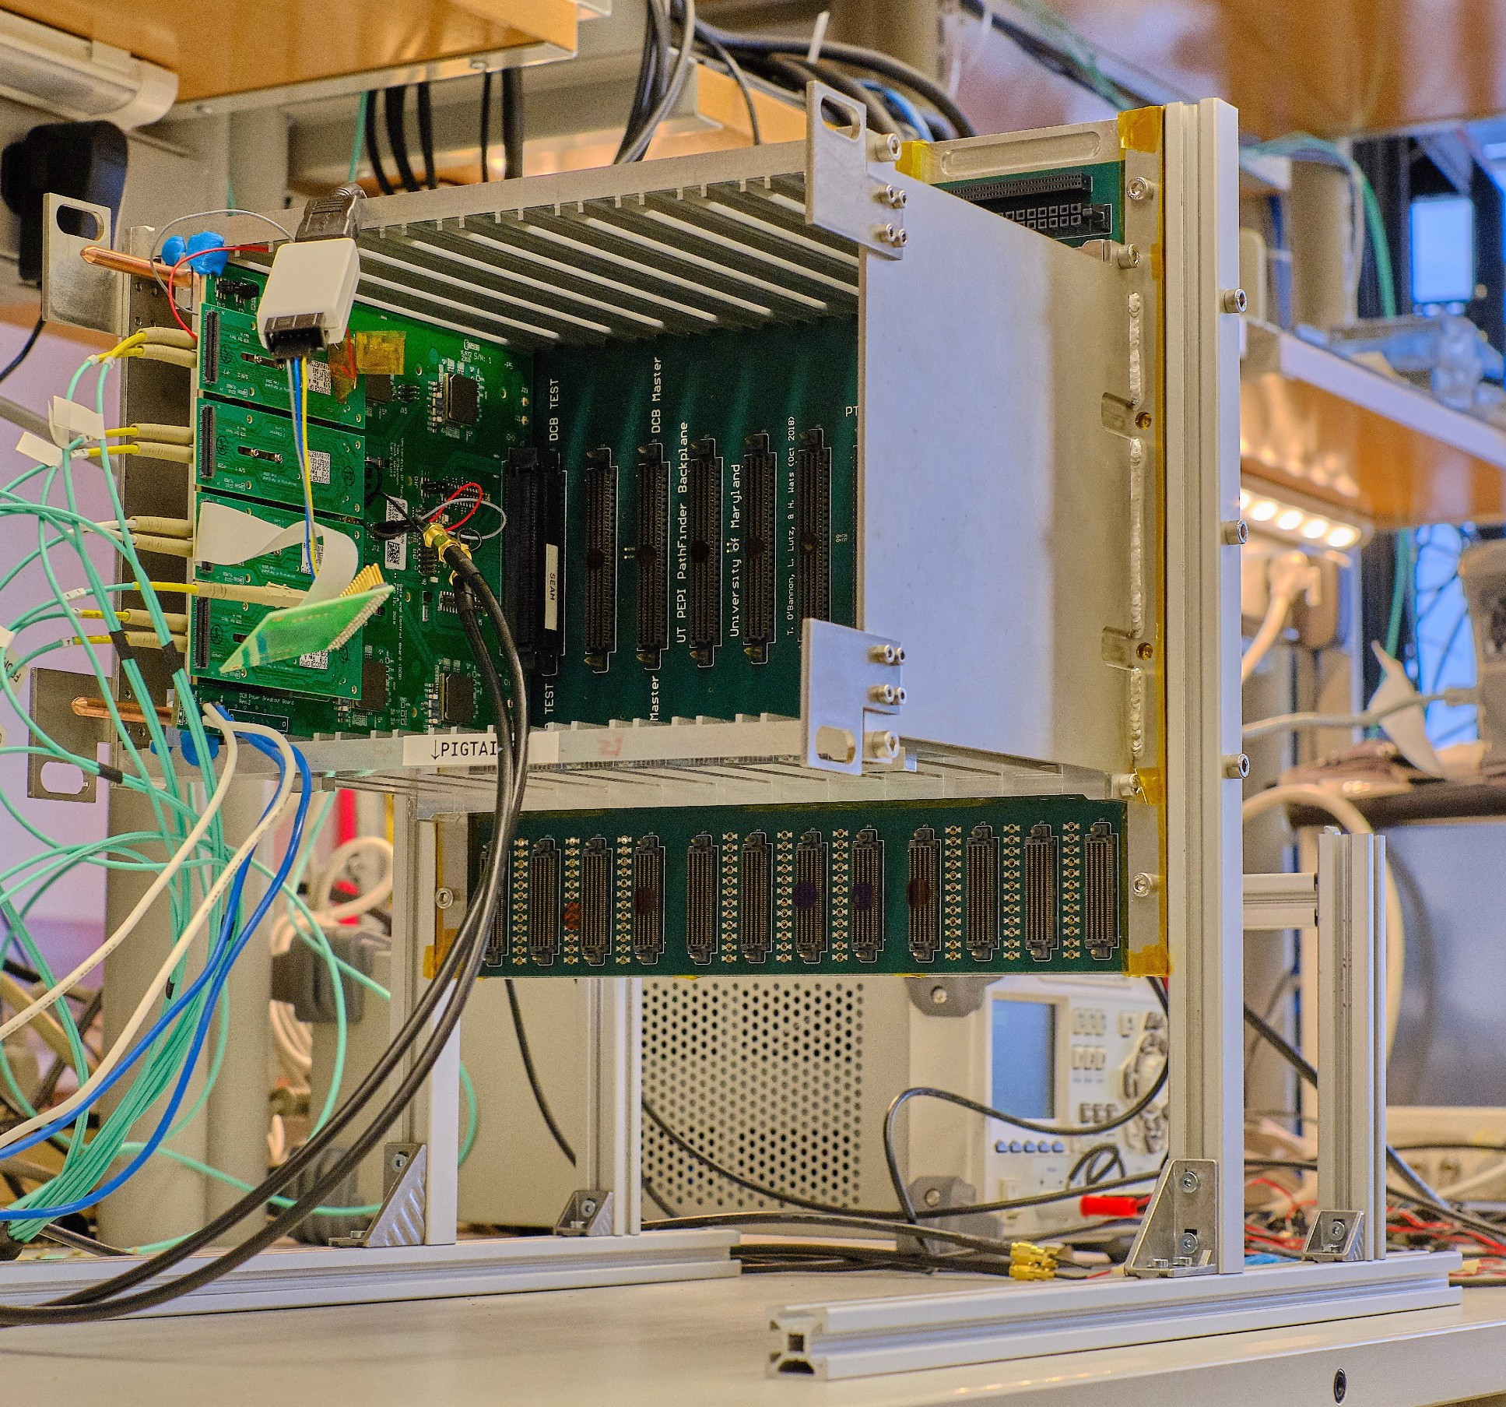

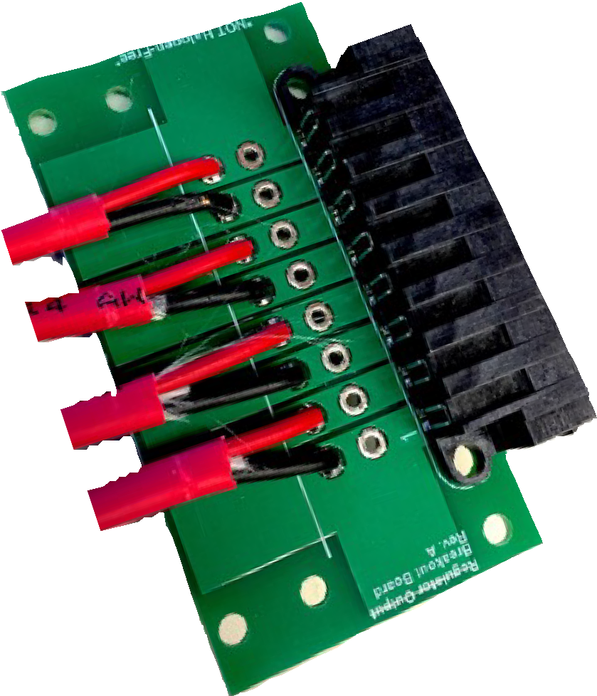
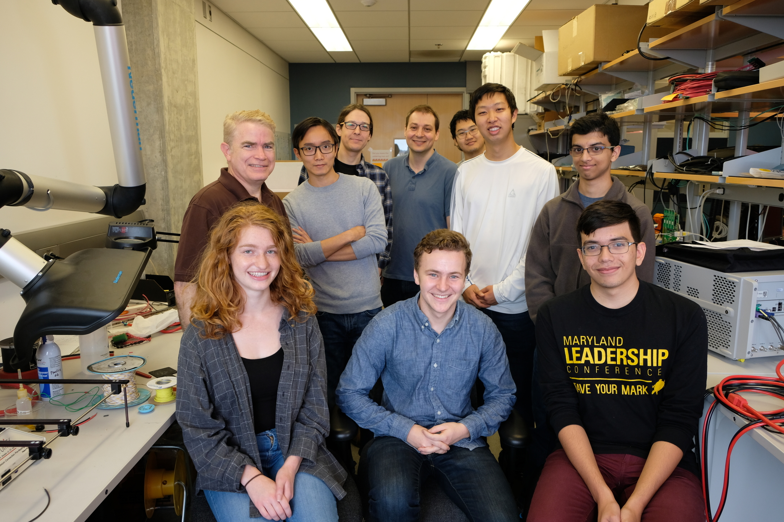

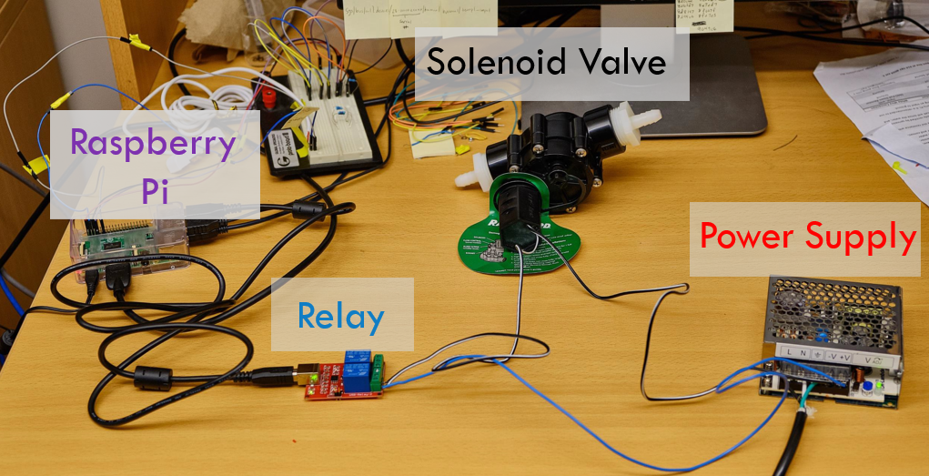




Development of the LHCb Upstream Tracker at UMD
By Jorge Ramirez
Advised by Professors Manuel Franco Sevilla & Hassan Jawahery
The Upstream Tracker is one of the electronics upgrades being made to LHCb, improving the experiment’s ability to track the paths of charged particles following collisions. The particles that pass through the detector deposit charge through four layers of silicon. These charge deposits are then analyzed and their trajectory can be deduced.
The University of Maryland is contributing to the LHCb upgrade with the design, construction, and installation of three electronic systems that will organize the flow of data from the sensors, package the data and convert it to an optical signal, and provide power to the detector.
DATA from silicon sensors
Backplanes
One backplane can route up to 12 DCB’s
Backplanes: The backplane is the circuit board that receives digitized data about the charge deposits from the silicon sensors and routes it to up to 12 data control boards.
Data Control Boards (DCBs): The DCBs are boards that receive data from the backplane and use 7 CERN-designed chips to serialize the data and send it out via fiber optical cables at 4.8 Gb/s.
Low Voltage Regulators (LVRs): The LVRs are power supply boards that are designed to be able to provide 1.2v, 1.5v, and 2.5v power rails to the electronics in the UT with very little fluctuation.
Data Control Boards
Proton Beam from LHC
Low Voltage
Regulators
Optical Signal
Converter
P
P
248 DCBs x 6 cables
x 4.8 Gb/s per cable
Particles resulting from proton collisions have their trajectories detected and recorded by silicon sensors with special chips
Data Filtering Algorithm
The backplane’s role is to distribute the data from the Upstream Tracker’s silicon micro-strip detectors, as well as providing a frame for the LVRs and data processing DCBs. These boards also route power to all the new electronics system and silicon detectors in the upstream tracker.
The low voltage regulators are critical to the functionality of the detector. These boards provide stable power sources of 1.2v, 1.5v, and 2.5v to the silicon detectors whose ASICs cannot handle a surge of higher than 1.575V before being permanently damaged.
The Data Control Board (DCB) is the powerhouse circuit board that is designed to handle the large amounts of data routed from the silicon sensors. It has three main responsibilities:
Serializes the 320 Mb/s data from the silicon sensors into a single 4.8 Gb/s line in its CERN-made GBTx ASICs.
Converts the electrical signals to optical signals by feeding the data into four modular optical transceivers.
The GBTxs sends control signals to the ASICs located on the silicon sensors.
(above) Ben soldering resistors onto a module that connects to the LVR
DCB with Master and Slave GBTx ASICs.
DCB connected to a backplane
LVR input fuse board
LVR output boards
(above) A picture of the front-side of the backplane, with the matching PCB schematic showing the 28-layer distribution of connections and vias.
(above) Jorge and Rohan configuring the variable resistors and confirming the stability of the 1.2/1.5/2.5 power lines
Low Voltage Regulator
Our current work involves a large-scale production of these three electronic systems. The manufactured boards must be tested and configured on a board-by-board basis and then undergo an intense burn-in phase before finally shipping them to CERN. To test the DCBs, we send a stream of data using specialized COMET boards and verify their integrity with python algorithms.
The last step before installation is the burn-in, which will occur during Summer 2019 and will have two main objectives. The LVRs will be stress-tested by being connected to several resistive load boards in order to test any voltage fluctuations. The DCBs will be stress-tested with dummy data to verify their longevity. The burn-in will occur in two equal sized batches.
The UMD LHCb Team!
The burn-in will require several safety systems that will be controlled by Raspberry Pi’s.
Here is the relay controlled watercooling system that will be used to thermally cycle the electronics.
0110001
Optical Fiber
MiniDAQ
(Linux)
COMET
daughter
board
`
PC
(Windows)
FPGA
DCB
USB
FPGA
COMET
Optical converter
0110001
COMET
daughter
board
Backplane
Notes:
We expect our ability to record data to go from 600 MB/s to a maximum of 5 GB/s! i.e. the difference between downloading 10 three-hour movies in 2.5 hours vs 15 minutes!

